Slide 1

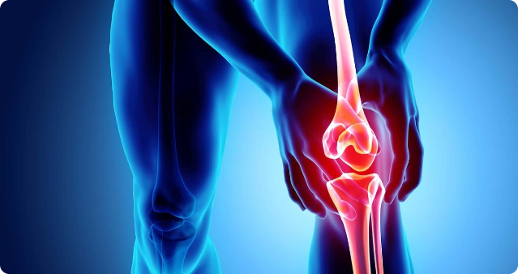
0
Knee Osteoarthritis Detection
by Harishanker P
S3 MCA

Slide 2
Contents
Introduction
Importance of Early Detection
Problem Statement and Motivation
Literature Review
Comparison
Knee X-ray Image Dataset
Kellgren-Lawrence Grading System
Proposed Model

Slide 3

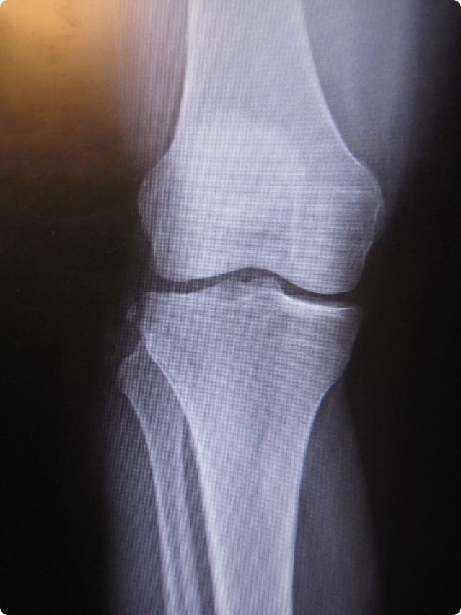
Introduction to Knee Osteoarthritis
1
Degenerative Disease
Breakdown of cartilage in the knee joint.
2
Pain and Stiffness
Common symptoms affecting mobility.
3
Long-Term Impact
Can lead to disability and decreased quality of life.
1

Slide 4

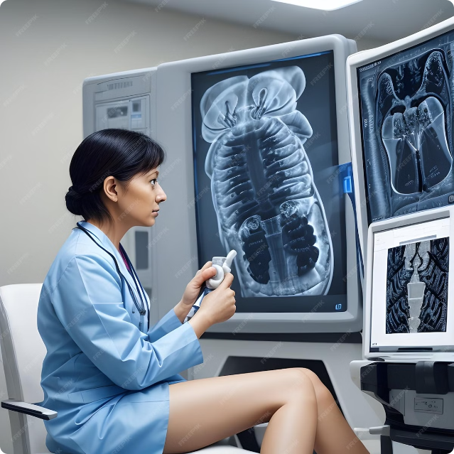
Importance of Early Detection
Improved Treatment Outcomes
Earlier interventions can slow progression.
Reduced Pain and Disability
Preventing further damage to the joint.
Enhanced Quality of Life
Maintaining mobility and independence.
2

Slide 5
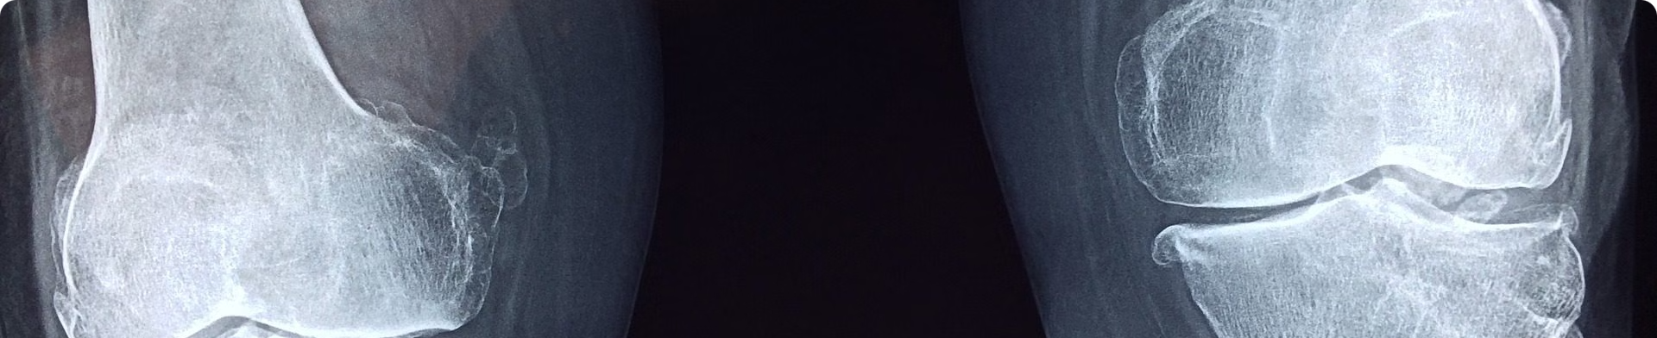



Problem Statement and Motivation
Accurate Diagnosis
Automated System
Improved Patient Care
Challenges in early detection.
Using deep learning to assist clinicians.
Facilitating timely and effective treatment.
3

Slide 6
Literature Review 1
TITLE
Transfer Learning-Based Smart Features Engineering for Osteoarthritis Diagnosis From Knee X-Ray Images
ABOUT
IEEE Access, Volume 11, 2023
DATASET
Osteoarthritis Initiative (OAI) dataset with 9,786 X-ray images
ALGORITHM
CRK (CNN Random forest K-neighbors)
ACCURACY
99%
4

Slide 7
Literature Review 2
TITLE
Knee Osteoarthritis Detection and Classification Using X-Rays
ABOUT
IEEE Access, Volume 11, 2023
DATASET
OsteoArthritis Initiative (OAI) dataset with 9,786 X-ray images
ALGORITHM
Ensemble (VGG19, ResNet34, DenseNet121, DenseNet161)
ACCURACY
98%
5

Slide 8
Literature Review 3
TITLE
A Sequential VGG16+CNN-Based Automated Approach With Adaptive Input for Efficient Detection of Knee Osteoarthritis Stages
ABOUT
IEEE Access, Volume 12, 2024
DATASET
1,650 digital X-ray images of knee joints from hospitals and diagnostic centers
ALGORITHM
VGG16+CNN
ACCURACY
93.27%
6

Slide 9
Comparison
TITLE
DATASET
ALGORITHM
ACCURACY
Transfer Learning-Based Smart Features Engineering for Osteoarthritis Diagnosis From Knee X-Ray Images
Osteoarthritis Initiative (OAI) dataset with 9,786 X-ray images
CRK (CNN Random forest K-neighbors)
99%
Knee Osteoarthritis Detection and Classification Using X-Rays
Osteoarthritis Initiative (OAI) dataset with 9,786 X-ray images
Ensemble (VGG19, ResNet34, DenseNet121, DenseNet161)
98%
A Sequential VGG16+CNN-Based Automated Approach With Adaptive Input for Efficient Detection of Knee Osteoarthritis Stages
1,650 digital X-ray images of knee joints from hospitals and diagnostic centers
VGG16+CNN
93.27%
7

Slide 10

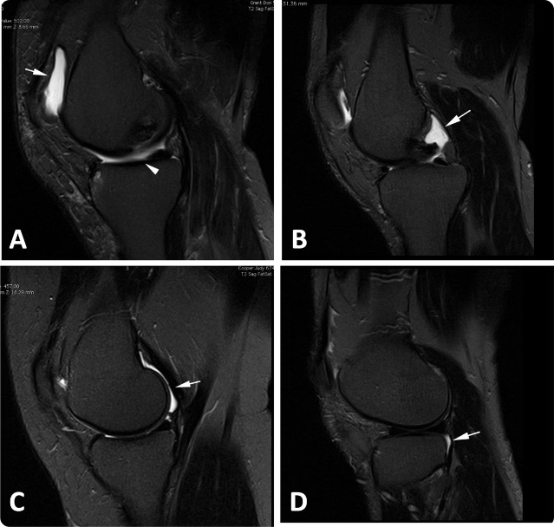
Knee X-ray Image Dataset
Source
Osteoarthritis Initiative (OAI) dataset Kaggle
Size
9000+ images
Types
Anterior-posterior (AP) views
8

Slide 11
Kellgren-Lawrence Grading System
Grade 0
1
No signs of osteoarthritis.
2
Grade 1
Doubtful narrowing of joint space.
Grade 2
3
Minimal joint space narrowing.
4
Grade 3
Moderate joint space narrowing.
Grade 4
5
Severe joint space narrowing.
9

Slide 12
Proposed Model
Hybrid Deep Learning Model : VGG16 + CNN
Process Knee X ray Image
Detect knee osteoarthritis
Classify based on KL grading (5 Classes)
10

Slide 13

The End.
Thank you for you attention.
11

